Slide 1
Computer Networks
Prabhu Subramanian
prabhus@wilp.bits-pilani.ac.in

Slide 2

IMP Note to Self

Slide 3
Important Note to Students
It is important to know that just login to the session does not guarantee the attendance.
Once you join the session, continue till the end to consider you as present in the class.
IMPORTANTLY, you need to make the class more interactive by responding to Professors queries in the session.
Whenever Professor calls your number / name, you need to respond, otherwise it will be considered as ABSENT

Slide 4
SEVZI ZC467 - COMPUTER NETWORKS
Lecture No. 01

Slide 5
Computer Networks
Interconnected collection of two or more autonomous computers.
Two or more computers are said to be connected only if they can exchange information (data) among themselves.
The word data refers to information presented in whatever form agreed upon by the parties creating and using the data.
Data communications are the exchange of data between two devices via some form of transmission medium.

Slide 6
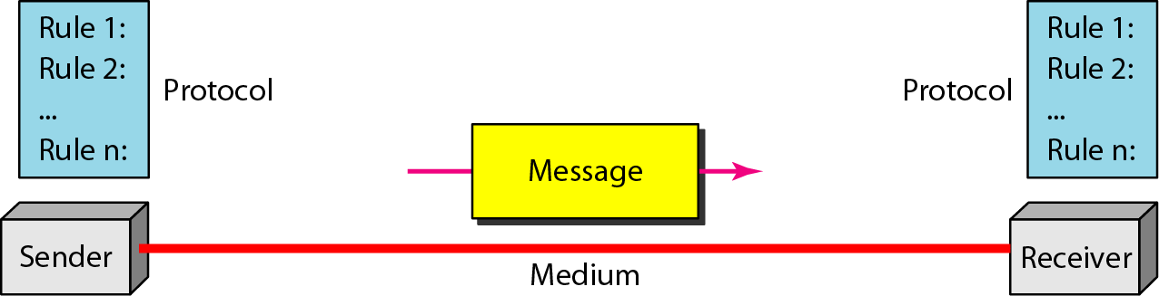
Five Components of Data Communication
Message
Sender
Receiver
Transmission medium
Protocol

Slide 7
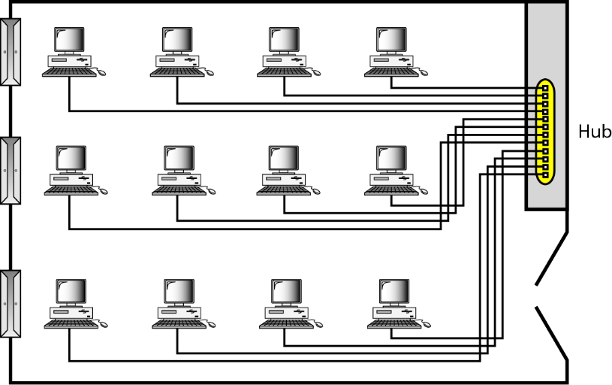
LAN (Local Area Network)
10m-1km distance
Room,building,campus
10Mbps-100Mbps
Size-restricted
Transmission technology-Cables
Topology-bus,ring

Slide 8
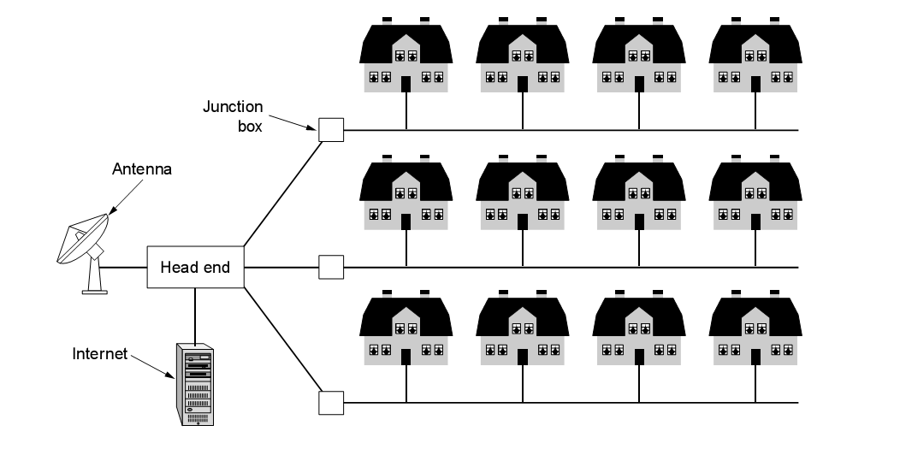
MAN (Metropolitan Area Network)
10km-100km distance
City
Eg: Cable television N/W

Slide 9
WAN (Wide Area Network)
100km-10000km distance
Country, continent, planet
Eg: Internet
Traditional applications - E-mail, News, Remote login, File transfer

Slide 10
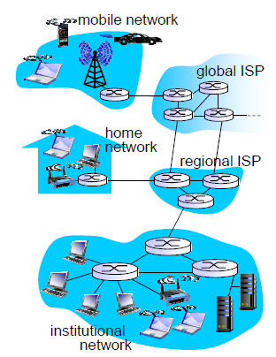
Network Structure
Network edge: applications and hosts (clients and servers).
Access networks, physical media: wired, wireless communication links
Network core:
  interconnected routers
  network of networks (Internet)

Slide 11
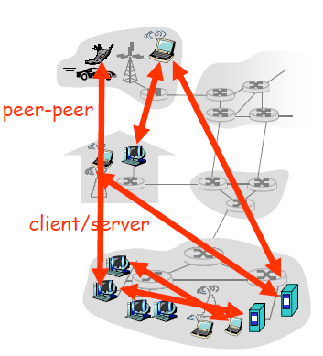
Network Edge
End systems (hosts):
  run application programs at "edge
  of network” e.g. Web, email
client/server model
  client host requests, receives service from always-on server e.g. Web browser/server; email client/server
peer-peer model:
  minimal (or no) use of dedicated servers
  e.g. Skype, Bit-Torrent

Slide 12
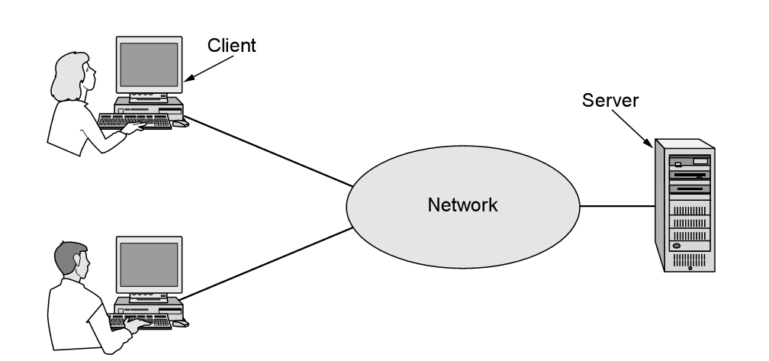
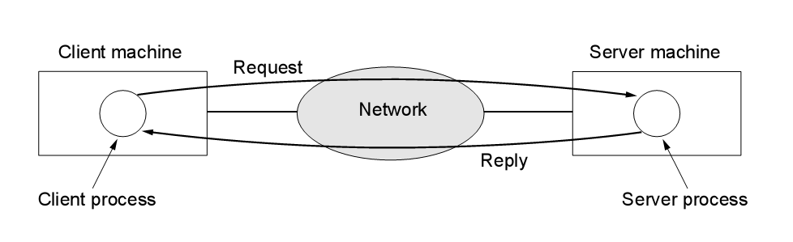

Slide 13
Connection-Oriented Service / Connectionless Service
Steps – call setup, data transfer, call termination
Adv – fixed path, order of messages preserved, no loss of data
Reliable data transfer
Receives ACK, adds on overhead & delay
Eg: telephone, FTP
Each packet sent independently
Routing decisions made at every intermediate system
Eg: email, remote login
Use of IP
Adv – Flexibility, robust, no unnecessary overhead
Unreliable, no guaranteed delivery & order of delivery

Slide 14
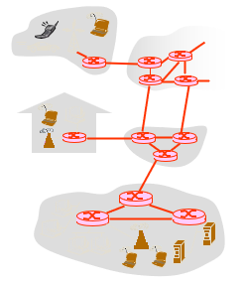
The Network Core
mesh of interconnected routers
the fundamental question: how is data transferred through net?
  circuit switching: dedicated circuit per call: telephone net
  packet-switching: data sent thru net in discrete “chunks”

Slide 15

Network Core: Circuit Switching
End-end resources reserved for “call”
link bandwidth, switch capacity
dedicated resources: no sharing
circuit-like (guaranteed) performance
call setup required

Slide 16
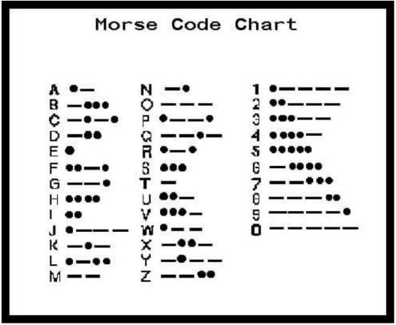
Message Switching
Eg: Telegraph n/ws
Transmit text messages over long distances
Text message is converted to codes
Morse codes
Uses the concept of store-and-forward
Header contains destination address

Slide 17
Circuit Switching
Eg: Telephone n/ws
2-way transmission of voice signals across a network
Early days-dedicated lines
Now-switches
Packet Switching
Eg: Internet

Slide 18
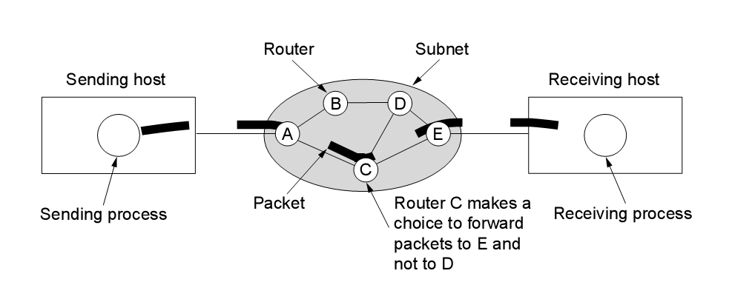




Store & Forward Packet Switching
L bits
per packet
source
3
2
1
R bps
R bps
destination

Slide 19
Internet structure: network of networks
roughly hierarchical
at center: “tier-1” ISPs (e.g., Verizon, Sprint, AT&T, Cable and Wireless), national/international coverage
  treat each other as equals
Tier-1 providers interconnect (peer) privately
Tier 1 ISP
Tier 1 ISP
Tier 1 ISP

Slide 20
Internet structure: network of networks
“Tier-2” ISPs: smaller (often regional) ISPs
  Connect to one or more tier-1 ISPs, possibly other tier-2 ISPs
Tier-2 ISPs also peer privately with each other.
Tier-2 ISP pays tier-1 ISP for connectivity to rest of Internet
tier-2 ISP is customer of
tier-1 provider
Tier-2 ISP
Tier-2 ISP
Tier 1 ISP
Tier 1 ISP
Tier 1 ISP
Tier-2 ISP
Tier-2 ISP
Tier-2 ISP

Slide 21
Internet structure: network of networks
“Tier-3” ISPs and local ISPs
  last hop (“access”) network (closest to end systems)
local
ISP
Tier 3
ISP
local
ISP
local
ISP
local
ISP
Local and tier- 3 ISPs are customers of
higher tier ISPs
connecting them to rest of Internet
Tier-2 ISP
Tier-2 ISP
Tier 1 ISP
Tier 1 ISP
Tier 1 ISP
Tier-2 ISP
Tier-2 ISP
Tier-2 ISP
local
ISP
local
ISP
local
ISP
local
ISP

Slide 22
Internet structure: network of networks
a packet passes through many networks!
local
ISP
Tier 3
ISP
local
ISP
local
ISP
local
ISP
Tier-2 ISP
Tier-2 ISP
Tier 1 ISP
Tier 1 ISP
Tier 1 ISP
Tier-2 ISP
Tier-2 ISP
Tier-2 ISP
local
ISP
local
ISP
local
ISP
local
ISP

Slide 23
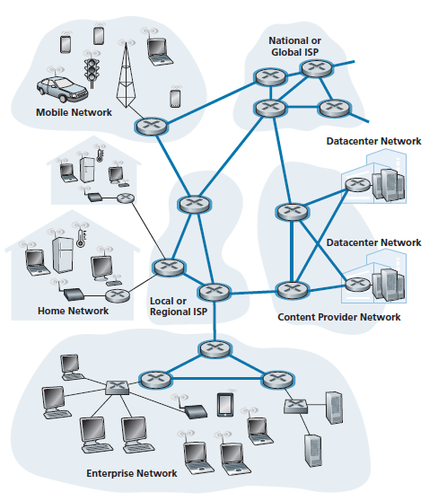
Network Core
Network core

Slide 24
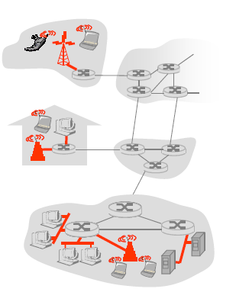
Access networks
How to connect end systems to edge router?
residential access nets
institutional access networks (school, company)
mobile access networks

Slide 25
Access Network: Dial Up(1)
Drawback:
        up to 56Kbps direct access to router (often less)
        Can’t surf and phone at same time: can’t be “always on”

Slide 26
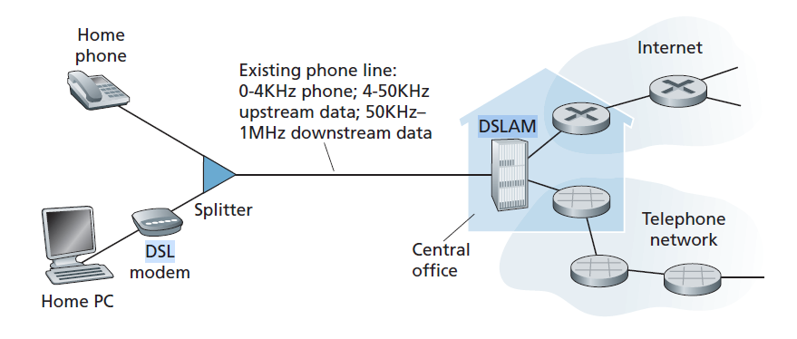
Access networks: DSL
digital subscriber line access multiplexer
(DSLAM)
DSL Internet access

Slide 27
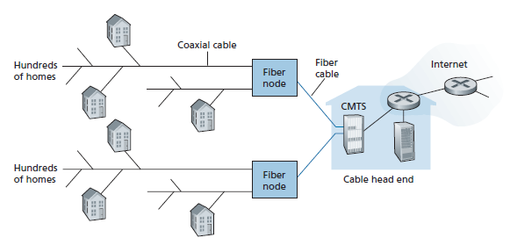
Access Network: Cable(1)

Slide 28
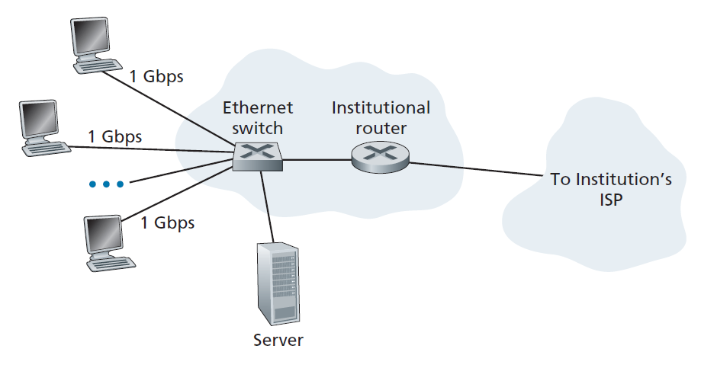
Access Network: Ethernet

Slide 29
Access Networks / Physical Media
Wired(Guided)/Wireless(Unguided)
Eg: twisted pair, coaxial cable, optical fiber
Provide point-to-point communication
Signal energy is contained & guided within a solid medium
Installation process is complicated, costly & time consuming
Eg: radio transmission, infrared, microwave transmission, air
Communication is broadcast in nature
Signal energy propagates in the form of unguided electro-magnetic signals
Quick and cost is low (antennas)

Slide 30
Wired(Guided)/Wireless(Unguided)
N/W topology is discrete
Attenuation α d
Additional transmission capacity can be procured by adding more wires
N/W topology is continuous
Attenuation α log₁₀ d
Not possible to procure additional capacity

Slide 31
How do loss and delay occur?
packets queue in router buffers
packet arrival rate to link exceeds output link capacity
packets queue, wait for turn
packet being transmitted (delay)
A
B
packets queueing (delay)
free (available) buffers: arriving packets
dropped (loss) if no free buffers

Slide 32
Four sources of packet delay
1. nodal processing:
  check bit errors
  determine output link
2. queueing
  time waiting at output link for transmission
  depends on congestion level of router
transmission
A
propagation
B
nodal
processing
queueing

Slide 33
Delay in packet-switched networks
3. Transmission delay:
R=link bandwidth (bps)
L=packet length (bits)
time to send bits into link = L/R
4. Propagation delay:
d = length of physical link
s = propagation speed in medium (~2x10⁸ m/sec)
propagation delay = d/s
Note: s and R are very different quantities!
transmission
A
propagation
B
nodal
processing
queueing

Slide 34
Caravan analogy
Difference between transmission delay and propagation delay
The transmission delay is the amount of time required for the router to push out the packet; it is a function of the packet’s length and the transmission rate of the link, but has nothing to do with the distance between the two routers.
The propagation delay, on the other hand, is the time it takes a bit to propagate from one router to the next; it is a function of the distance between the two routers, but has nothing to do with the packet’s length or the transmission rate of the link.

Slide 35
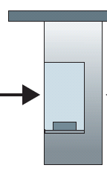
Caravan analogy
100 km
100 km
ten-car
caravan
toll
booth
toll
booth
cars “propagate” at
100 km/hr
toll booth takes 12 sec to service car (transmission time)
car~bit; caravan ~ packet
Q: How long until caravan is lined up before 2nd toll booth?
Time to “push” entire caravan through toll booth onto highway = 12*10 = 120 sec (10 cars)/(5 cars/minute) = 2 minutes
Time for last car to propagate from 1st to 2nd toll both: 100km/(100km/hr)= 1 hr
A: 62 minutes

Slide 36
Caravan analogy (more)
100 km
100 km
ten-car
caravan
toll
booth
toll
booth
Yes! After 7 min, 1st car at 2nd booth and 3 cars still at 1st booth.
1st bit of packet can arrive at 2nd router before packet is fully transmitted at 1st router!
  See Ethernet applet at AWL Web site
Cars now “propagate” at
1000 km/hr
Toll booth now takes 1 min to service a car
Q: Will cars arrive to 2nd booth before all cars serviced at 1st booth?

Slide 37
Nodal delay
d_{proc} = processing delay
  typically a few microsecs or less
d_{queue} = queuing delay
  depends on congestion
d_{trans} = transmission delay
  = L/R, significant for low-speed links
d_{prop} = propagation delay
  a few microsecs to hundreds of msecs

Slide 38
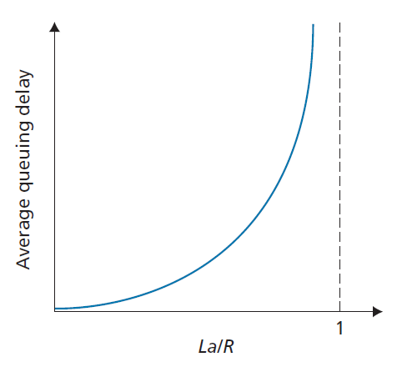

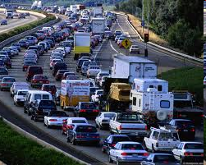
Queueing delay (revisited)
R=link bandwidth (bps)
L=packet length (bits)
a=average packet arrival rate
traffic intensity = La/R
La/R ~ 0
La/R ~ 0: average queueing delay small
La/R -> 1: delays become large
La/R > 1: more “work” arriving than can be serviced, average delay infinite!
La/R -> 1

Slide 39
“Real” Internet delays and routes
What do “real” Internet delay & loss look like?
Traceroute program: provides delay measurement from source to router along end-end Internet path towards destination. For all i:
  sends three packets that will reach router i on path towards destination
  router i will return packets to sender
  sender times interval between transmission and reply.
3 probes
3 probes
3 probes

Slide 40
“Real” Internet delays and routes
traceroute: gaia.cs.umass.edu to www.eurecom.fr
Three delay measurements from
gaia.cs.umass.edu to cs-gw.cs.umass.edu
1 cs-gw (128.119.240.254) 1 ms 1 ms 2 ms
2 border1-rt-fa5-1-0.gw.umass.edu (128.119.3.145) 1 ms 1 ms 2 ms
3 cht-vbns.gw.umass.edu (128.119.3.130) 6 ms 5 ms 5 ms
4 jn1-at1-0-0-19.wor.vbns.net (204.147.132.129) 16 ms 11 ms 13 ms
5 jn1-so7-0-0-0.wae.vbns.net (204.147.136.136) 21 ms 18 ms 18 ms
6 abilene-vbns.abilene.ucaid.edu (198.32.11.9) 22 ms 18 ms 22 ms
7 nycm-wash.abilene.ucaid.edu (198.32.8.46) 22 ms 22 ms 22 ms
8 62.40.103.253 (62.40.103.253) 104 ms 109 ms 106 ms
9 de2-1.de1.de.geant.net (62.40.96.129) 109 ms 102 ms 104 ms
10 de.fr1.fr.geant.net (62.40.96.50) 113 ms 121 ms 114 ms
11 renater-gw.fr1.fr.geant.net (62.40.103.54) 112 ms 114 ms 112 ms
12 nio-n2.cssi.renater.fr (193.51.206.13) 111 ms 114 ms 116 ms
13 nice.cssi.renater.fr (195.220.98.102) 123 ms 125 ms 124 ms
14 r3t2-nice.cssi.renater.fr (195.220.98.110) 126 ms 126 ms 124 ms
15 eurecom-valbonne.r3t2.ft.net (193.48.50.54) 135 ms 128 ms 133 ms
16 194.214.211.25 (194.214.211.25) 126 ms 128 ms 126 ms
17 * * *
18 * * *
19 fantasia.eurecom.fr (193.55.113.142) 132 ms 128 ms 136 ms
trans-oceanic
link
* means no response (probe lost, router not replying)

Slide 41
Packet loss
queue (aka buffer) preceding link in buffer has finite capacity
packet arriving to full queue dropped (aka lost)
lost packet may be retransmitted by previous node, by source end system, or not at all
buffer
(waiting area)
packet being transmitted
A
B
packet arriving to
full buffer is lost

Slide 42
Throughput
throughput: rate (bits/time unit) at which bits transferred between sender/receiver
  instantaneous: rate at given point in time
  average: rate over longer period of time
server, with
file of F bits
to send to client
link capacity
R_{s} bits/sec
link capacity
R_{c} bits/sec
server sends bits
(fluid) into pipe
pipe that can carry
fluid at rate
R_{s} bits/sec)
pipe that can carry
fluid at rate
R_{c} bits/sec)

Slide 43
Throughput (more)
R_{s} < R_{c} What is average end-end throughput?
R_{s} bits/sec
R_{c} bits/sec
R_{s} > R_{c} What is average end-end throughput?
R_{s} bits/sec
R_{c} bits/sec
bottleneck link
link on end-end path that constrains end-end throughput

Slide 44
Throughput: Internet scenario
per-connection end-end throughput: min(R_{c},R_{s},R/10)
in practice: R_{c} or R_{s} is often bottleneck
R_{s}
R_{s}
R_{s}
R
R_{c}
R_{c}
R_{c}
10 connections (fairly) share backbone bottleneck link R bits/sec

Slide 45
Protocol Hierarchies
To reduce their design complexity, most n/ws are organized as a series of layers
The contents & functions of each layer differ from network to network
The entities comprising the corresponding layers on different machines are called peers.
It is the peers that communicate using the protocol.

Slide 46
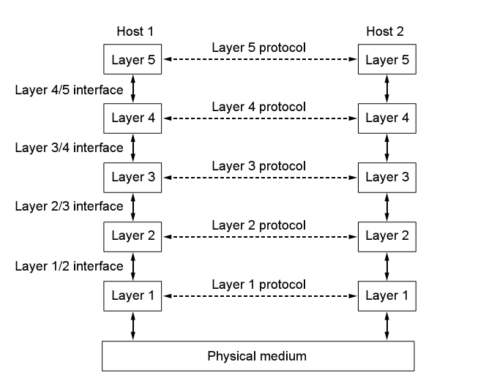

Slide 47
Design Issues for layers
Addressing – unique address for each system (How to identify senders & receivers)
Error Control – error detection and error correction
Flow Control – fast sender/slow receiver
Multiplexing – same connection may be used for multiple conversations
Routing – when there are multiple paths between source & a destination

Slide 48
Reference Models
The OSI Reference Model
The TCP/IP Reference Model
A Comparison of OSI and TCP/IP

Slide 49
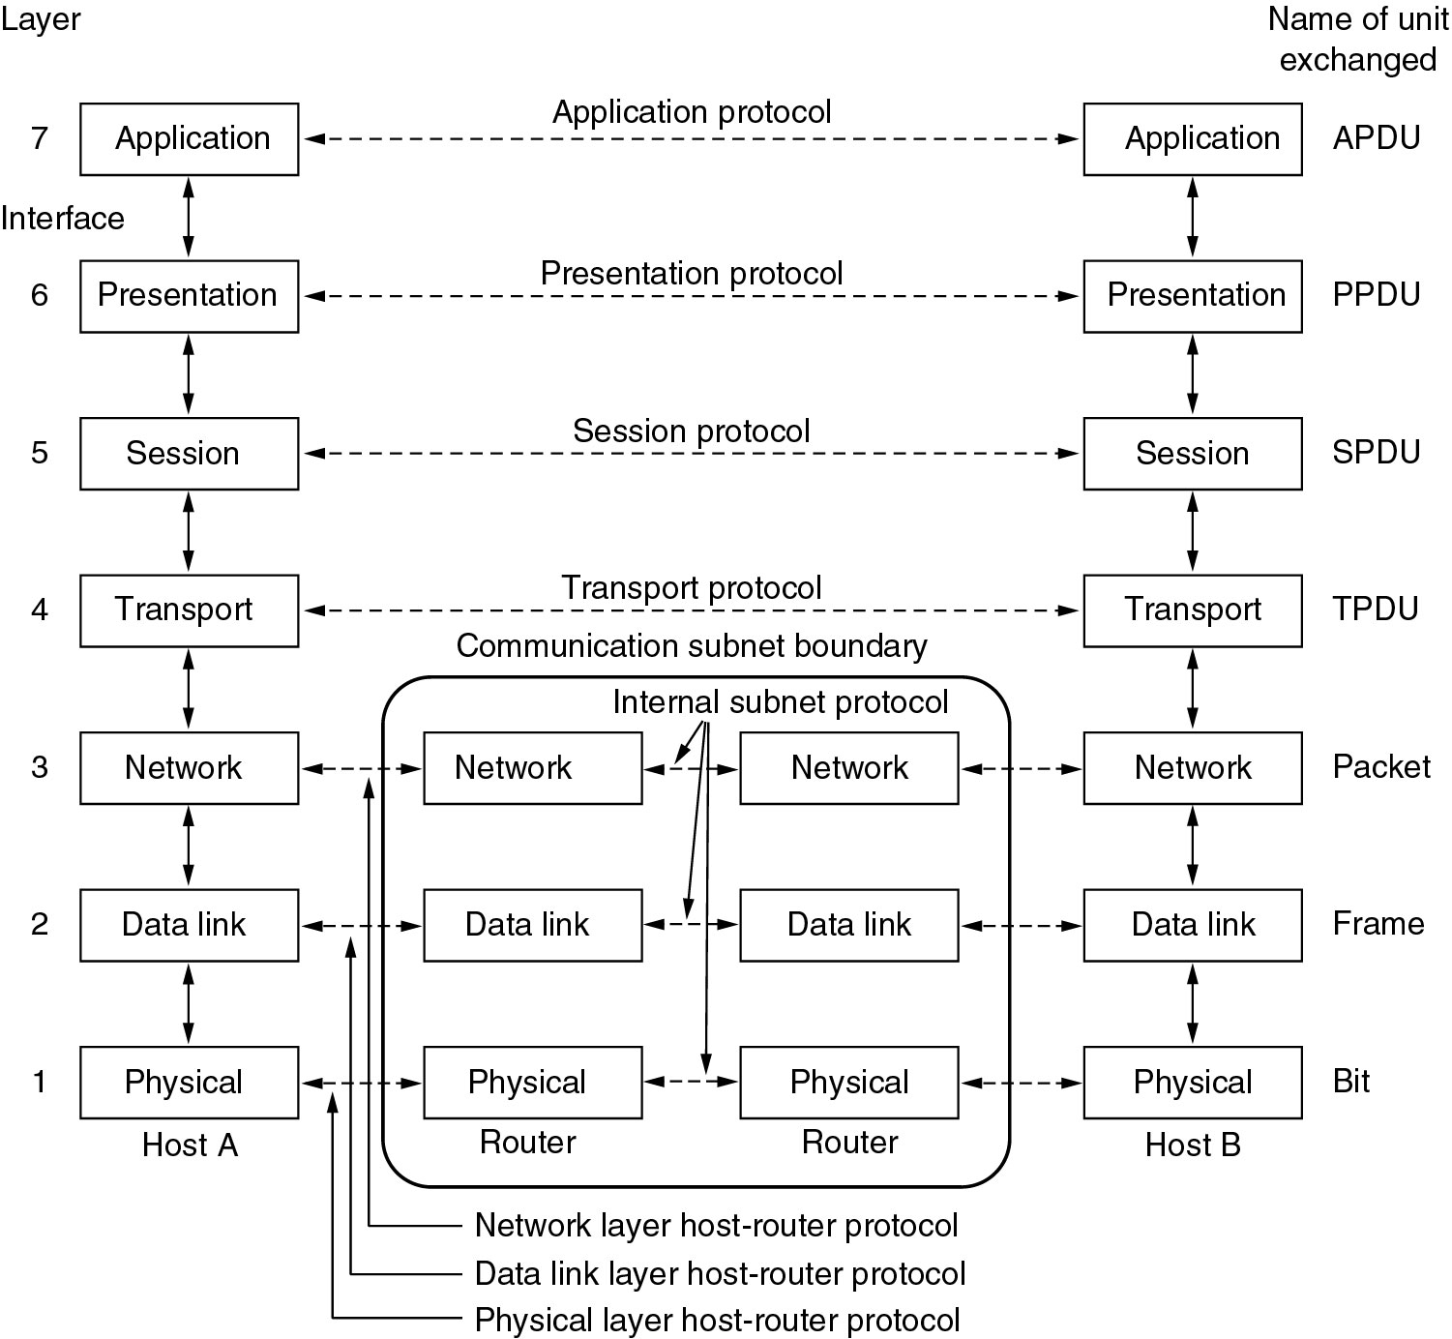
OSI Reference Model

Slide 50
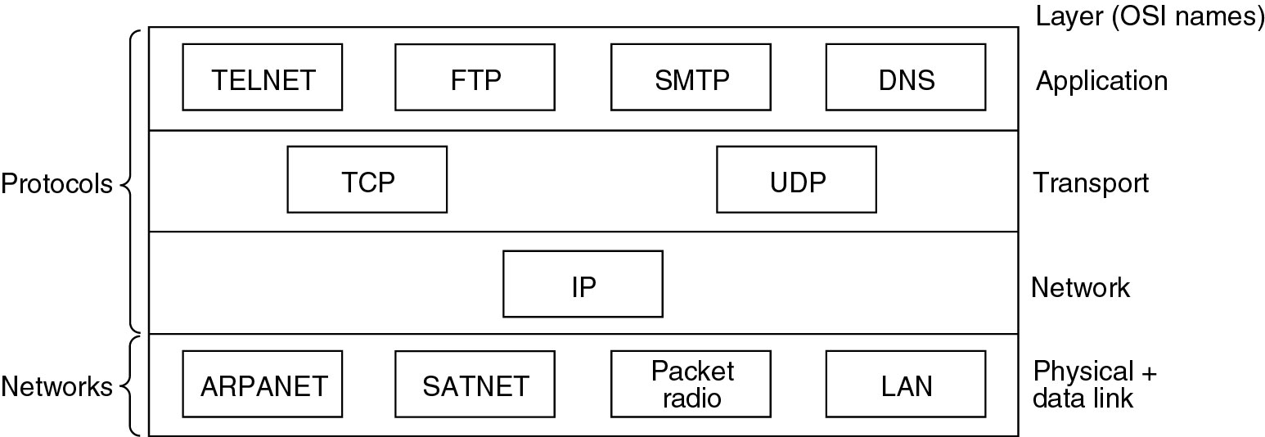
TCP/IP Reference Model
TELNET - Teletype Network
FTP - File Transfer Protocol
SMTP – Simple Mali Transfer Protocol
DNS – Domain Name System
TCP – Transmission Control Protocol
UDP – User Datagram Protocol
IP – Internet Protocol
ARPANET - Advanced Research Projects Agency Network
SATNET – Atlantic Packet Satellite Network

Slide 51
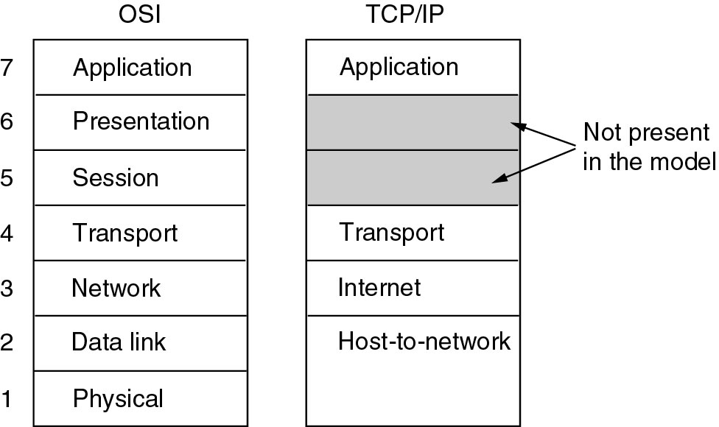
Comparision

Slide 52
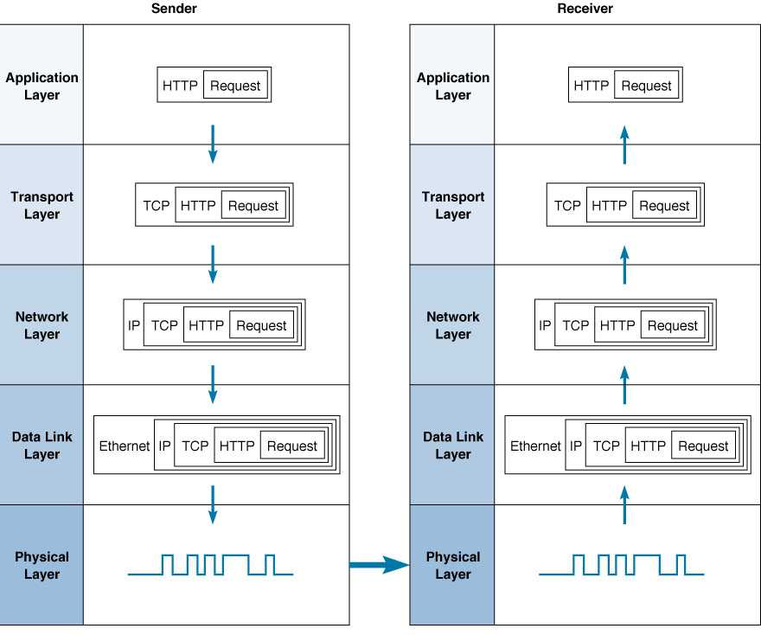
Example: TCP/IP’s 5-Layer Network Model

Slide 53
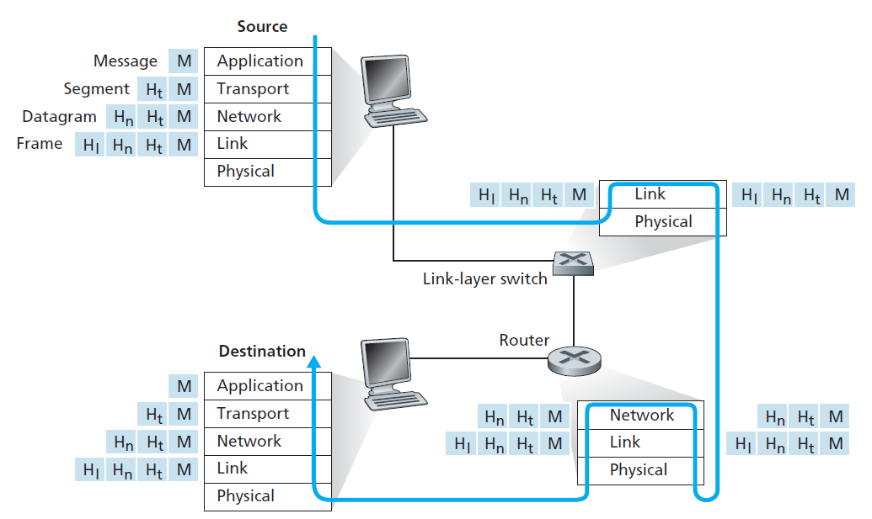
Encapsulation

Slide 54
Thank You!

Slide 55

END the session before leaving

